Slide 1

Sweet Home Finder
Web-based property finder

Slide 2
Purpose of our app:
Provide an easier way for people to browse through property listings online
Provide features such as highlighting amenities near a property and routes from a property to a frequently visited location (work, school, etc.)

Slide 3
Functional Requirements
The user must be able to register for an account in the system.
The user must be able to log into the system.
The user must be able to view an interactive map of Singapore.
The user must be able to search for properties based on keywords.
The user must be able to select a specific property to view more details of.
The user must be able to view nearby amenities to the selected property.
The user must be able to search for routes from the selected property to a location inputted by the user.

Slide 4
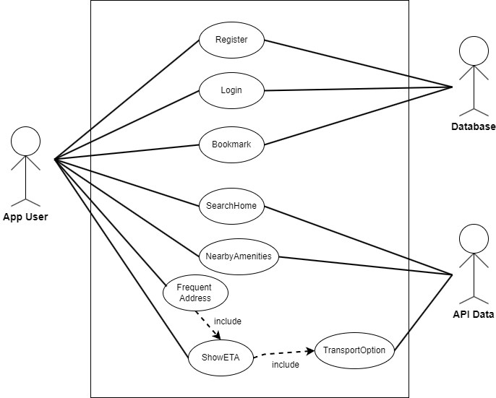

Slide 5
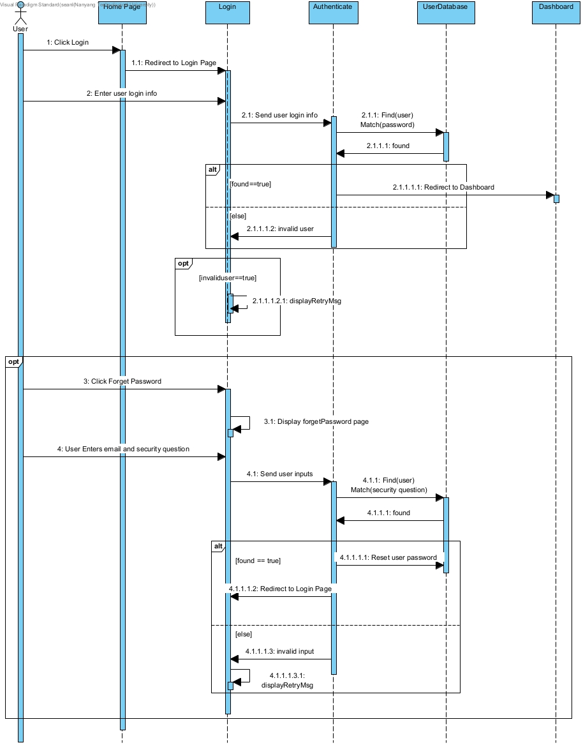
User Login

Slide 6
Forget Password

Slide 7
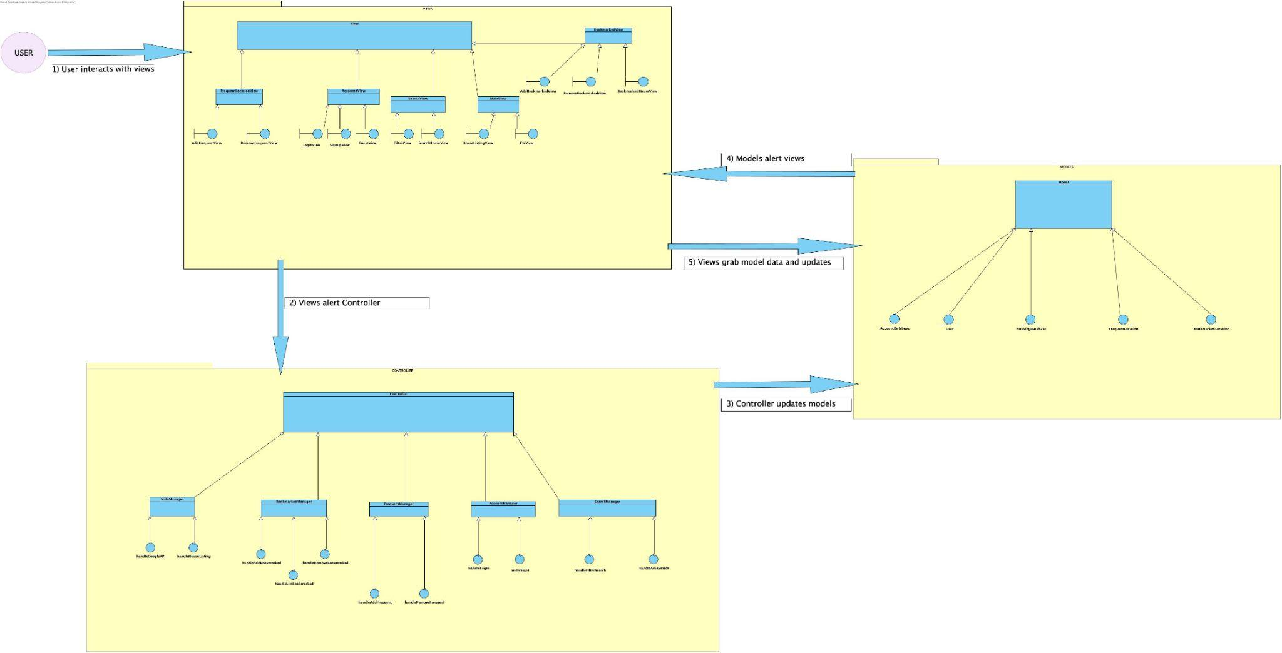

Slide 8
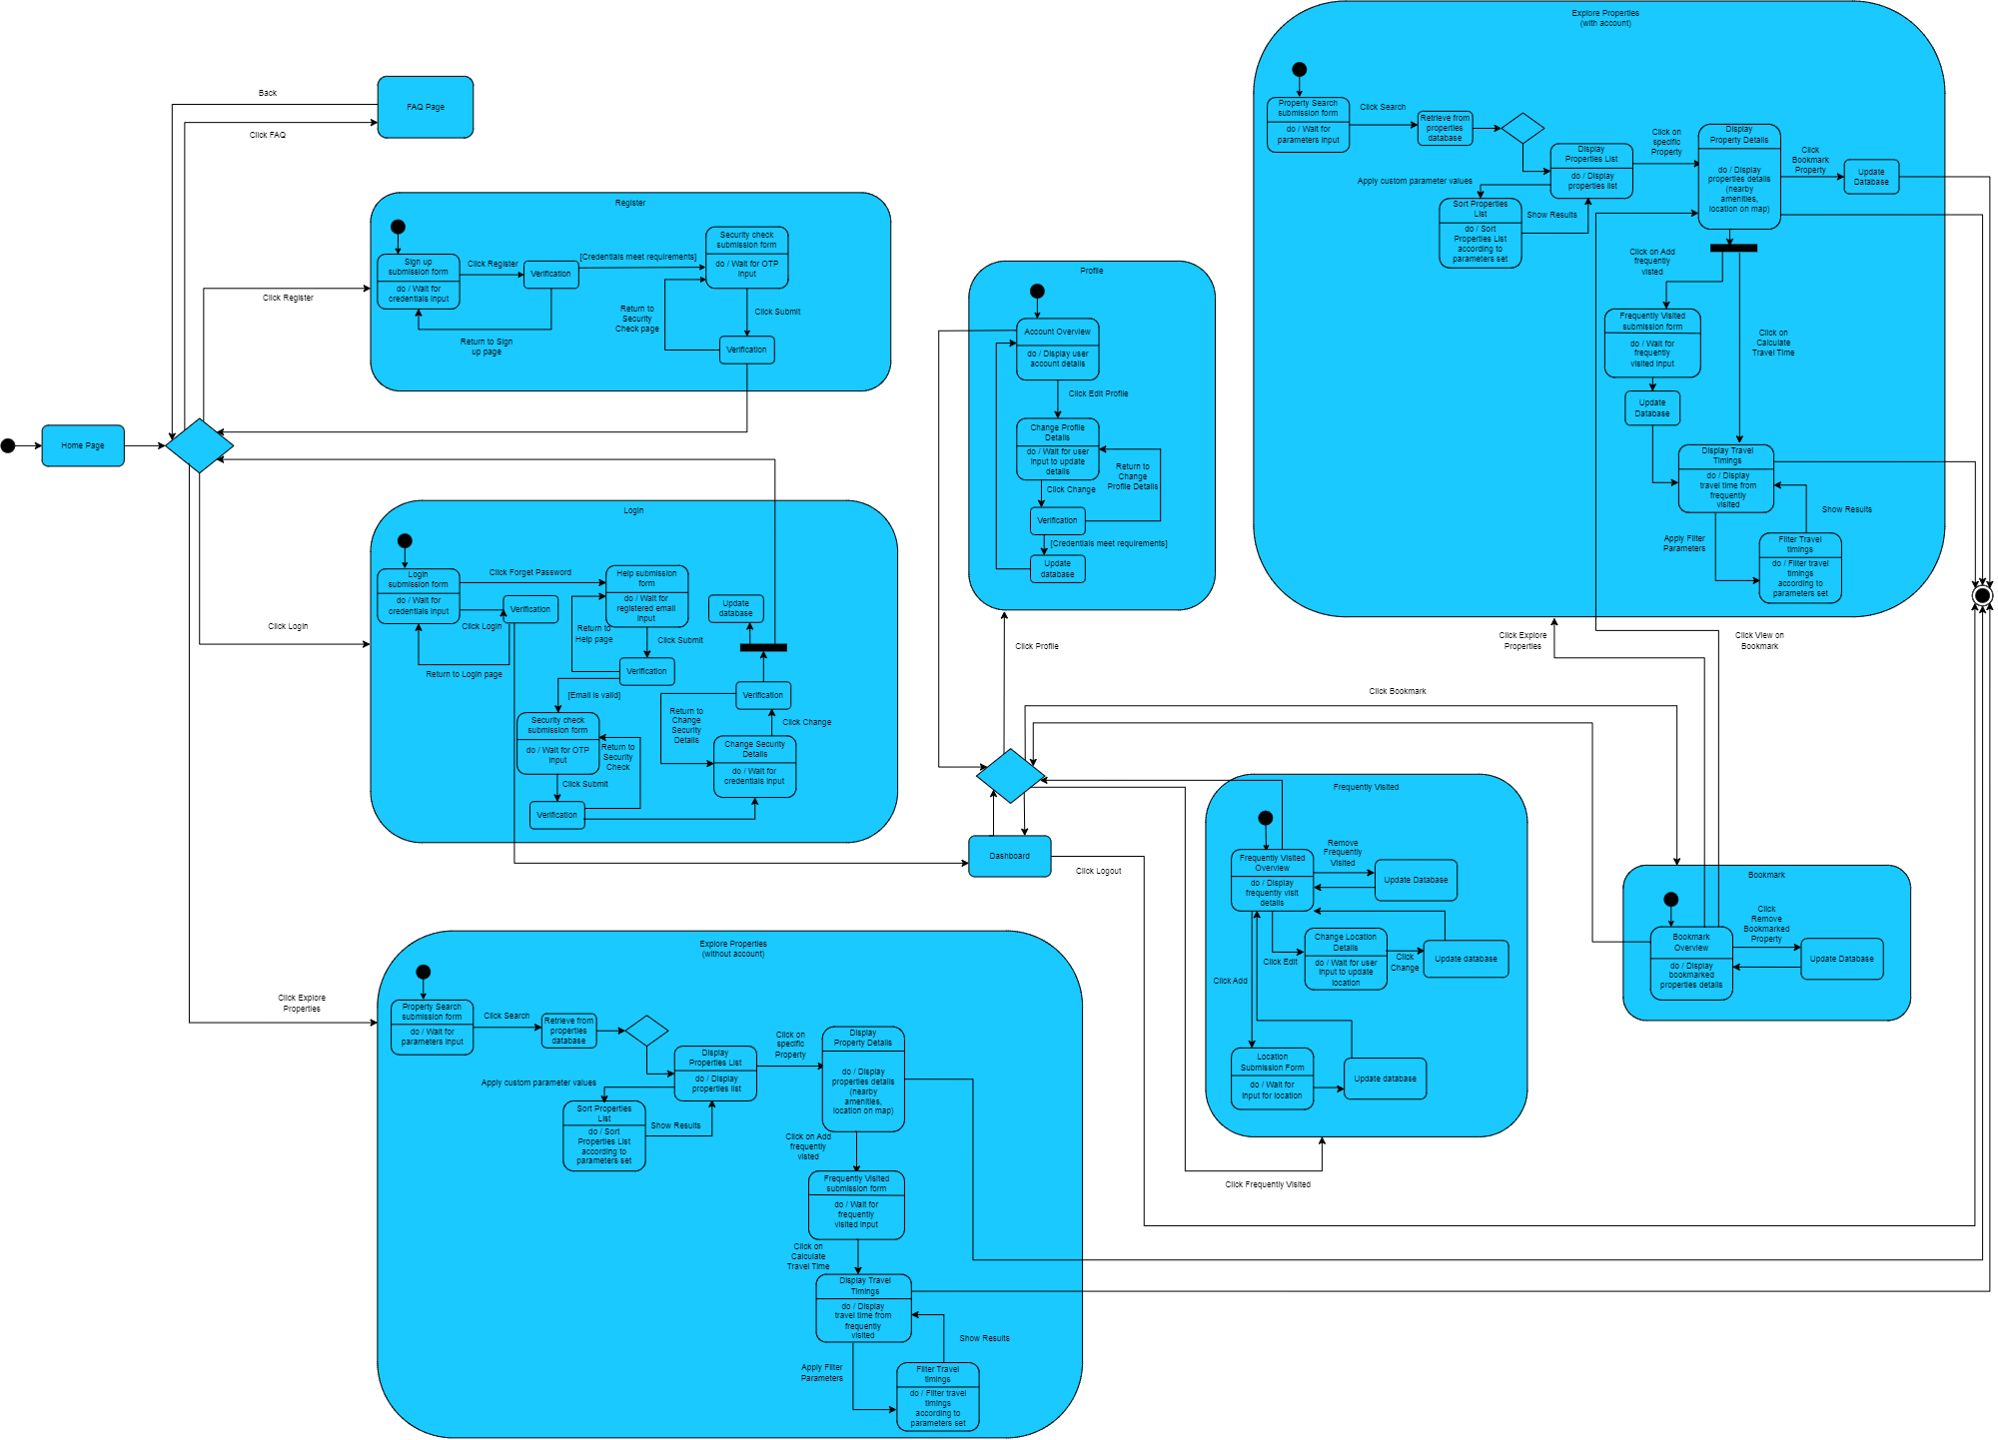
Initial Dialog Diagram

Slide 9






Stack Used:
Frontend
Backend

Slide 10
Live Demo

Slide 11
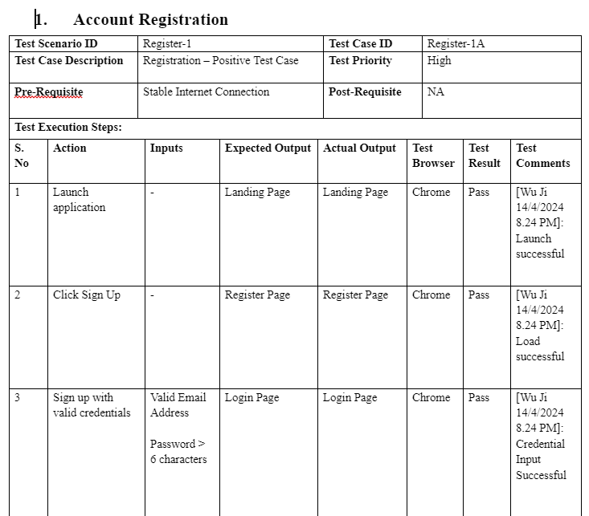
Test Cases

Slide 12
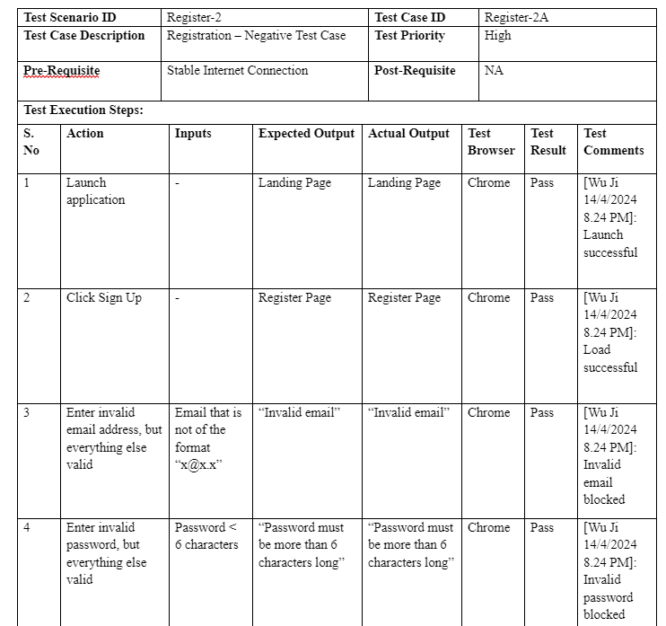

Slide 13
Good Software Engineering Design Practices
Version Control
Use of Github
Set up differents branches to implement new features and debug
Documentation
Use Case Model
System Architecture
Test Cases
Communication
Active communication between frontend and backend teams
Update the progress regularly to keep the team up to date
Refactoring and Code Cleanup
Improve code quality, readability, and maintainability

Slide 14
Good Software Engineering Design Practices
Modularity and Encapsulation
Module, service, controller modules have specific roles
Classes and components encapsulate relevant data and methods, generally adhering to having a single responsibility (Single Responsibility Principle)
DRY (Don't Repeat Yourself)
Common libraries (e.g. Formik, Yup, axios, bcrypt) reduce redundancy and promote consistency
Security
Use of hashed passwords, JWT for authentication, and route protection guards help protect user data and ensure that only authenticated users access certain endpoints
Nest.js’s dependency injection pattern decouples components from their dependencies
Components are more modular, testable and maintainable: open to extension, closed to modification (Open/Closed Principle)
Data Transfer Objects (DTOs)
Structure input data & maintains predictable application behavior and error management

